Slide 1
DEADLOCK
Mika Morgan

Slide 2
Deadlock Informal Definition
“Deadlock occurs if two processes need the same two resources to continue and each has ownership of one. Unless some action is taken, each process will wait indefinitely for the missing resource.”
Operating Systems: Internals and Design Principles, p. 107

Slide 3
Deadlock Formal Definition
“Deadlock can be defined as the permanent blocking of a set of processes that either compete for system resources or communicate with each other. A set of processes is deadlocked when each process in the set is blocked awaiting an event that can only be triggered by another blocked process.”
Operating Systems: Internals and Design Principles, p. 259
Notes:
Deadlock is permanent because none of the events is ever triggered. Unlike other problems in concurrent process management, there is no efficient solution in the general case.

Slide 4
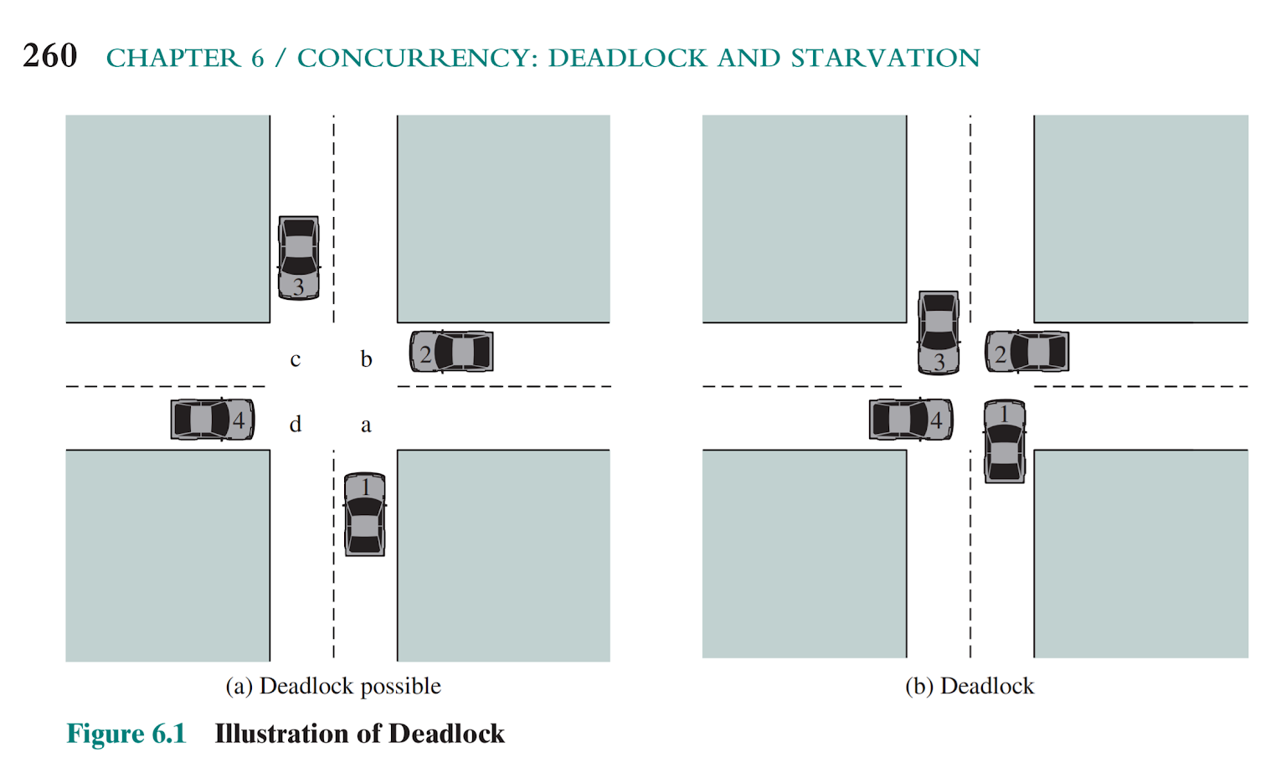
Classic Example: a Traffic Deadlock
Figure 6.1, from Operating Systems: Internals and Design Principles, p. 260.
-The left is only a potential deadlock, because the necessary resources are available for any of the cars to proceed. In an actual deadlock (right), none of the cars can move forward.

Slide 5
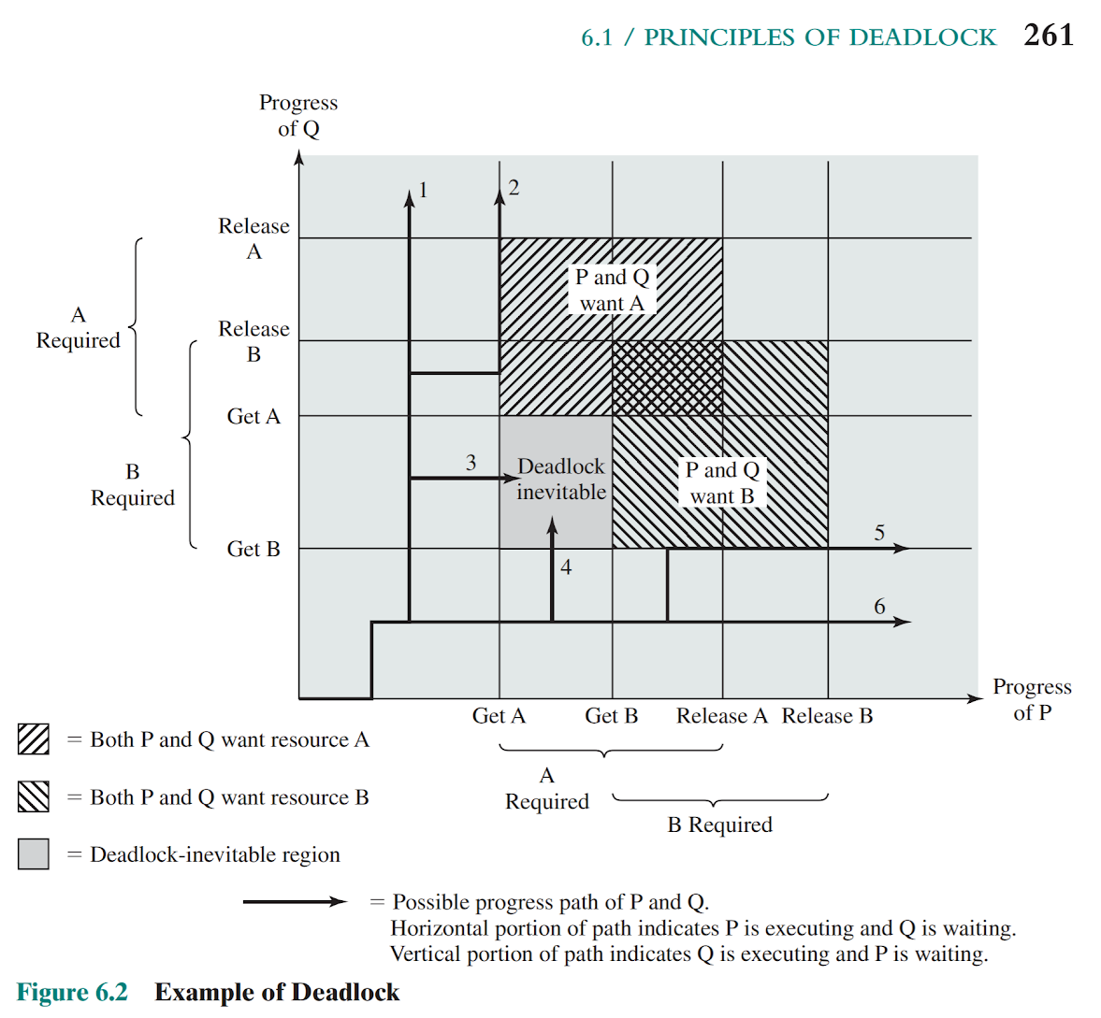
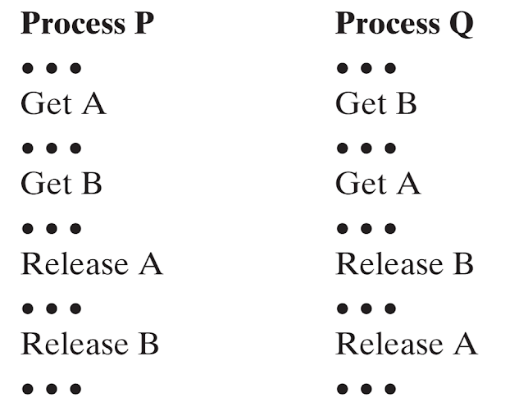
Joint Progress Diagram
Example of deadlock.
Each process needs exclusive use of both resources for a certain period of time.
Notes:
The gray-shaded area is referred to as the fatal region, applies to the commentary on paths 3 and 4. If an execution path enters this fatal region, then deadlock is inevitable. Deadlock is only inevitable if the joint progress of the two processes creates a path that enters the fatal region.

Slide 6
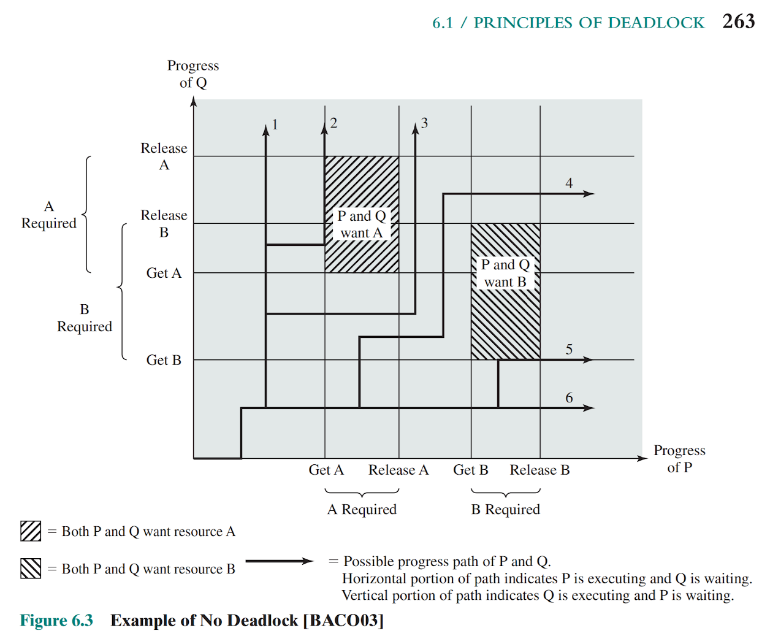
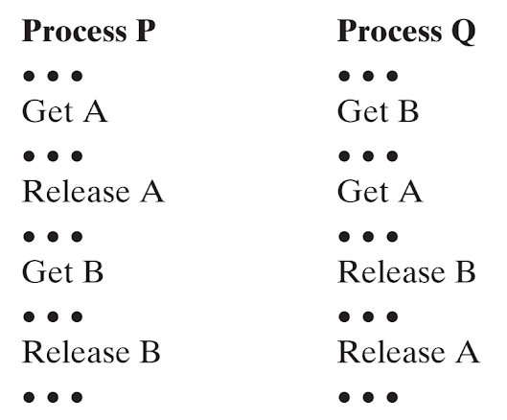
Joint Progress Diagram
Example of no deadlock.
Regardless of the relative timing, no deadlock can occur.

Slide 7
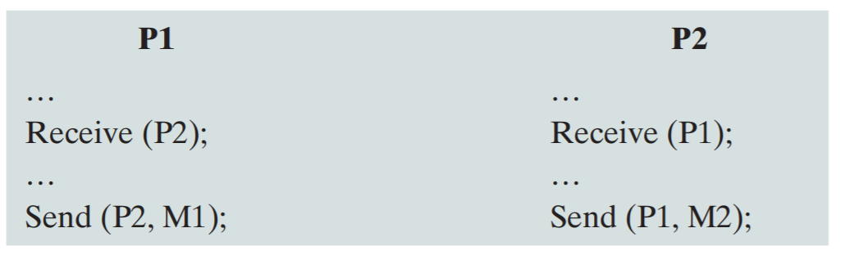
Resources
Reusable Resources:
Can be safely used by one process at a time, and is not depleted by that use
Examples include:
processors
I/O channels
main/secondary memory
Can cause deadlock if two reusable resources are both needed/locked by two processes
Can also cause deadlock if requests for main memory exceed the space available
Consumable Resources:
Can be created (produced) and destroyed (consumed)
Examples include:
interrupts
signals
messages

Slide 8
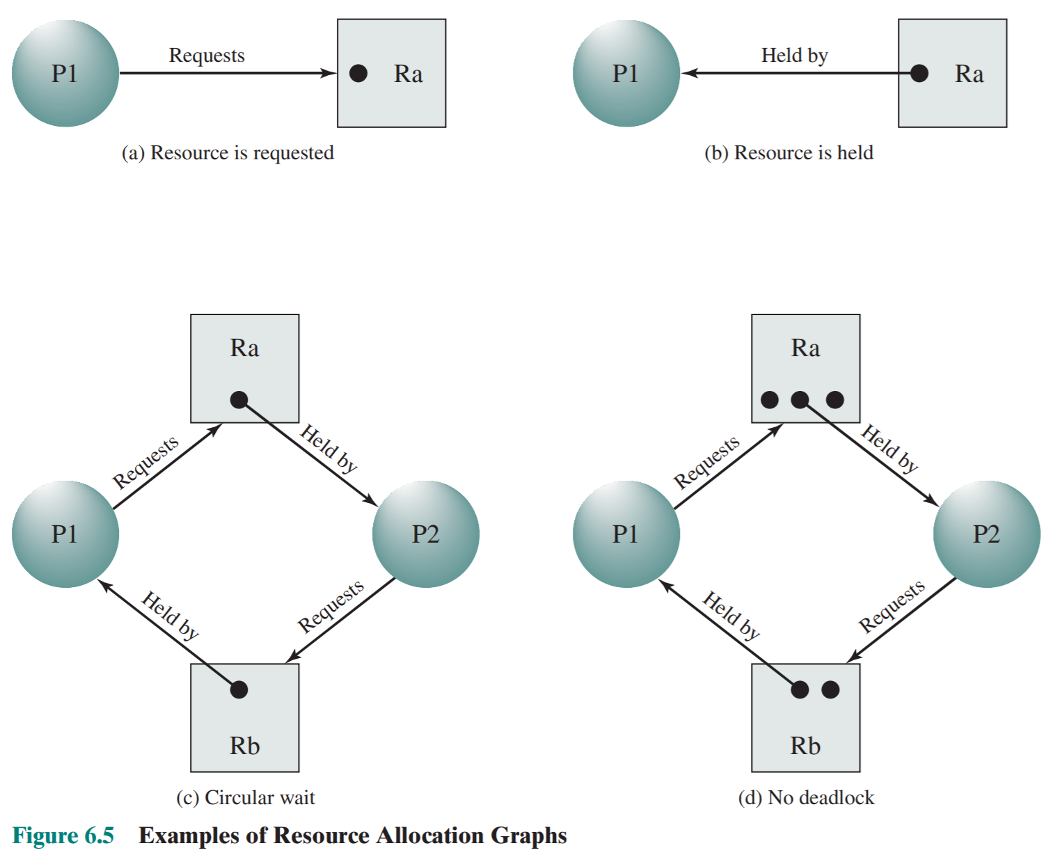
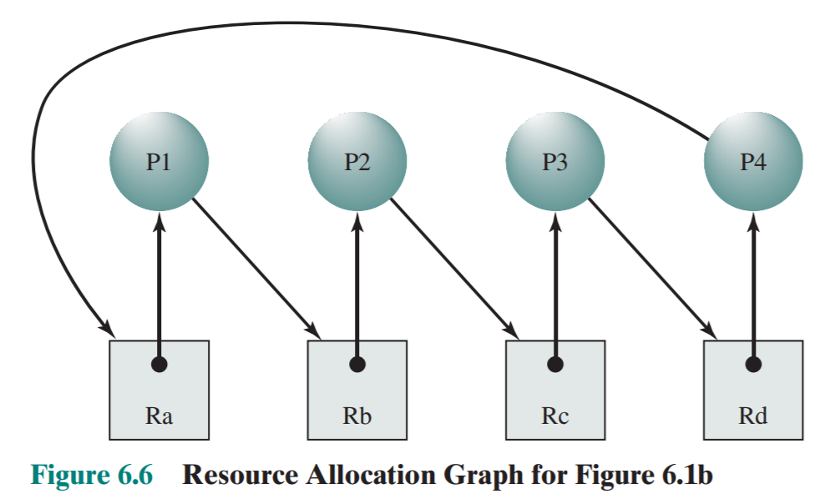
Resource Allocation Graphs
A resource allocation graph tracks which resource is held by which process and which process is waiting for a resource of a particular type. It is a very powerful and simple tool to illustrate how interacting processes can deadlock.
Deadlock

Slide 9
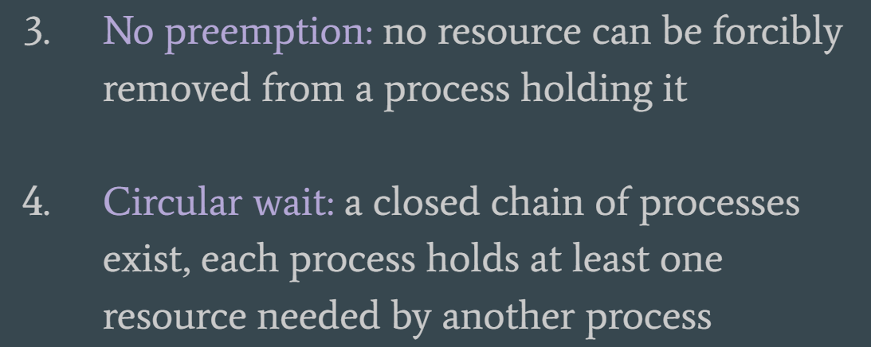
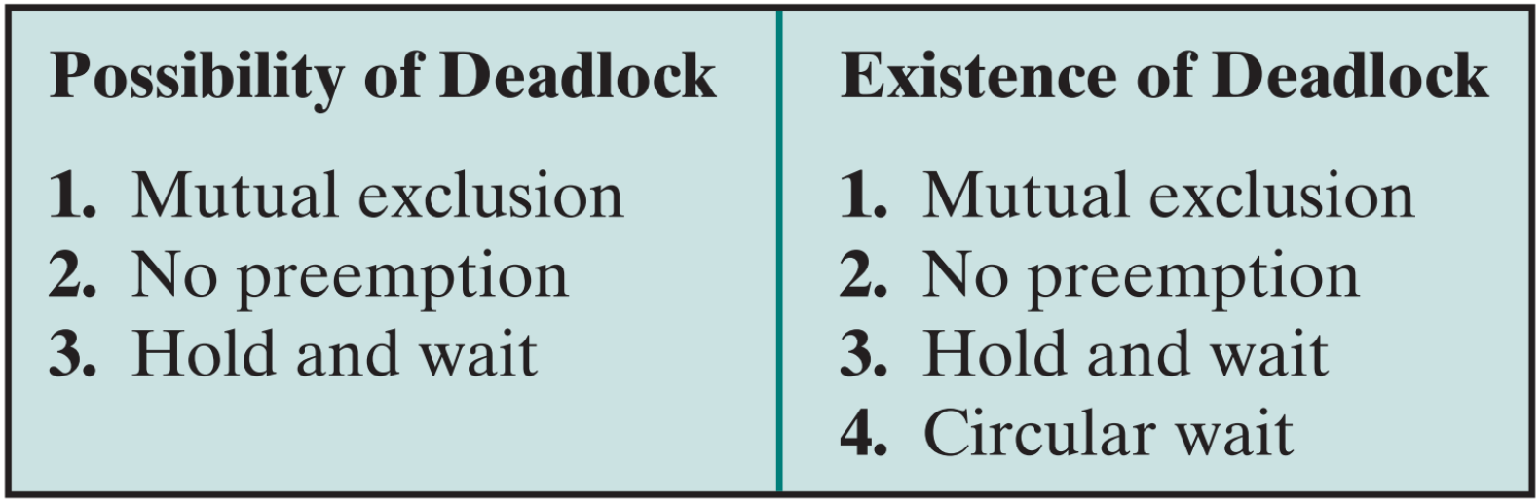
The Conditions for Deadlock
Mutual Exclusion: only one process may use a resource at a time
Hold and Wait: a process may hold allocated resources while awaiting assignment of other resources
Notes:
First 3 are necessary, but not sufficient

Slide 10
Dealing with Deadlock
Prevent deadlock ===> eliminate one of the four necessary conditions
Avoid deadlock ===> make dynamic choices to avoid based on resource allocation
Detect deadlock ===> four conditions are already met; take action to recover

Slide 11
Deadlock Prevention
Mutual exclusion: In general, cannot be disallowed.
Hold­ and ­wait: requiring that a process request all its required resources at one time and blocking the process until all requests can be granted simultaneously.
No preemption: if a process holding resources is denied a further request, that process must release its unused resources and request them again, together with the additional resource.
Circular Wait: defining a linear ordering of resource types, and only allowing requests in that order.
*Very conservative. Limits access to resources and not always worth it*

Slide 12
Deadlock Avoidance
Allows the necessary conditions, but dynamically makes decisions about whether the resource allocation request will potentially lead to a deadlock.
Requires knowledge of future requests for process resources.
Ways to avoid deadlock by careful resource allocation:
•Resource trajectories
•Safe/unsafe states
•Dijkstra’s Banker's algorithm

Slide 13

Banker’s Algorithm
-A resource allocation and deadlock prevention algorithm developed by Dijkstra for THE operating system.
-Tests for safety by simulating allocation of predetermined maximum possible amounts of all resources, and then makes an "s-state" check to test for possible deadlock conditions for all other pending activities, before deciding whether allocation should be allowed to continue.
Notes:
Advantage: Avoids deadlock and it is less restrictive than deadlock prevention.
Disadvantage: Only works with fixed number of resources and processes.
Guarantees finite time - not reasonable response time
Needs advanced knowledge of maximum needs

Slide 14
Banker’s Algorithm
max - allocation = need
https://www.youtube.com/watch?v=2V2FfP_olaA
Notes:
https://www.youtube.com/watch?v=2V2FfP_olaA

Slide 15
Deadlock Detection
Does not attempt to prevent deadlocks; lets them occur. The system detects when this happens, and then takes some action to recover reactively.
Methods of recovery:
-Abort all deadlocked processes
-Back up deadlocked process to last checkpoint and restart all processes
-Abort deadlocked processes one at a time until deadlock no longer exists
-Successively preempt resources until deadlock no longer exists
*Very liberal. Does not limit resource access or restrict process actions*

Slide 16
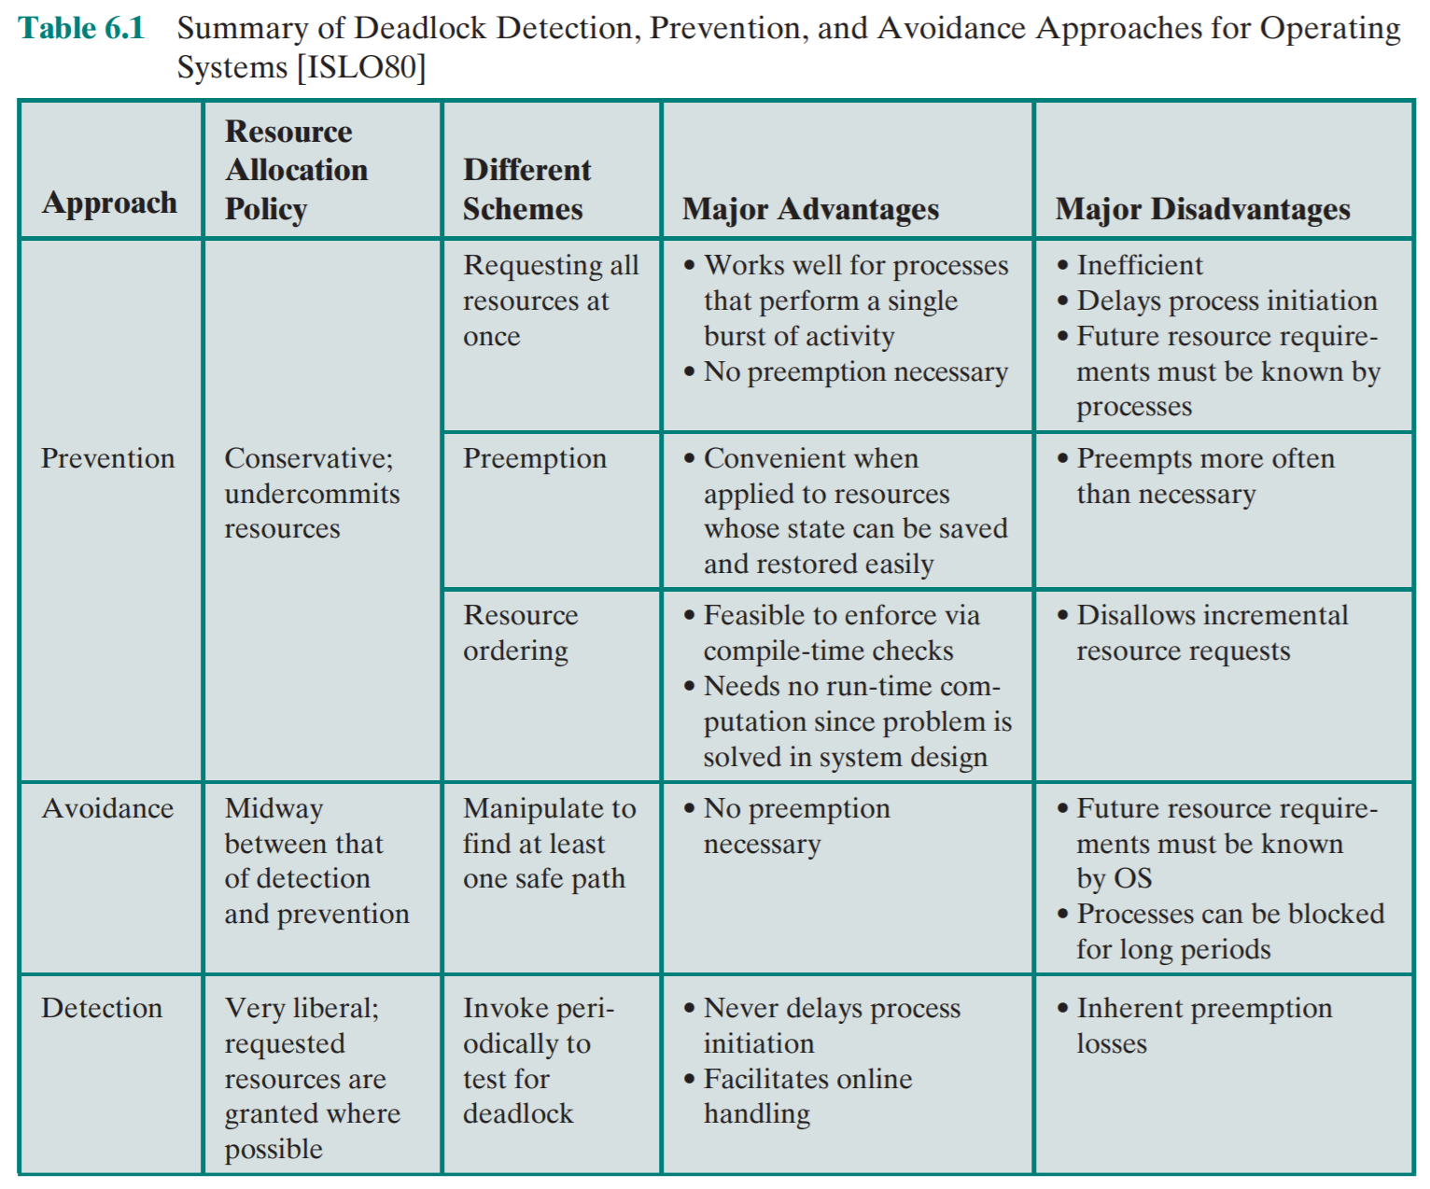

Slide 17
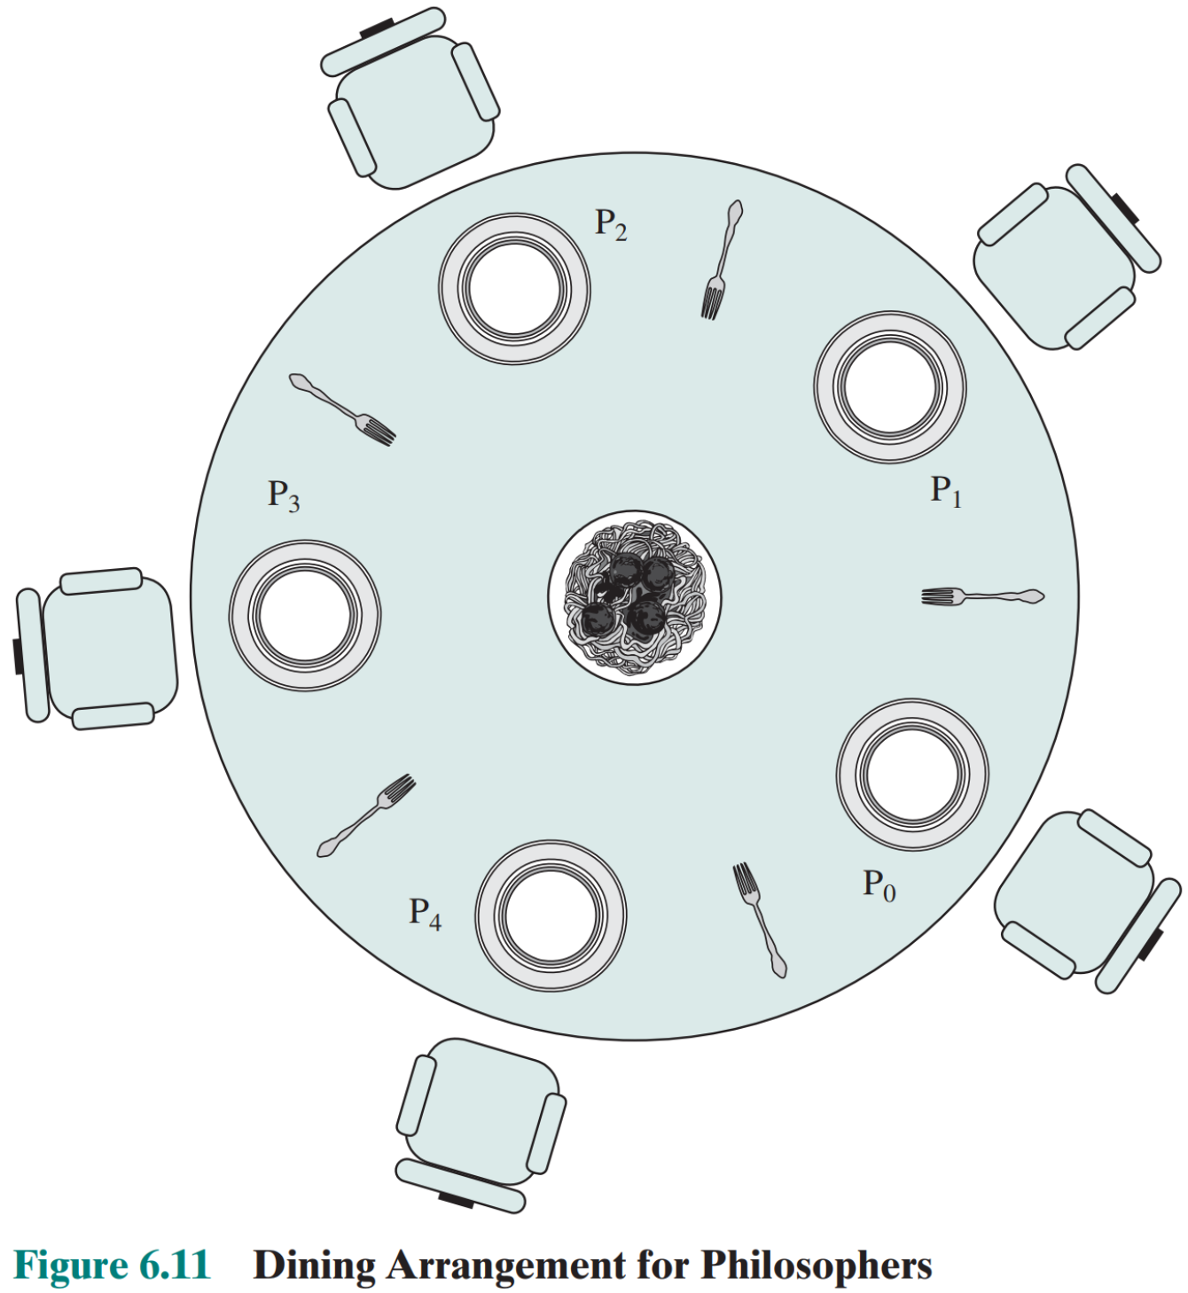
Dining Philosophers Question
Five dining philosophers sit down to eat spaghetti
Each one requires two forks to eat
No two diners can use the same fork at the same time (mutual exclusion)
Devise an algorithm that will allow all diners to eat, avoiding deadlock and starvation

